Slide 1
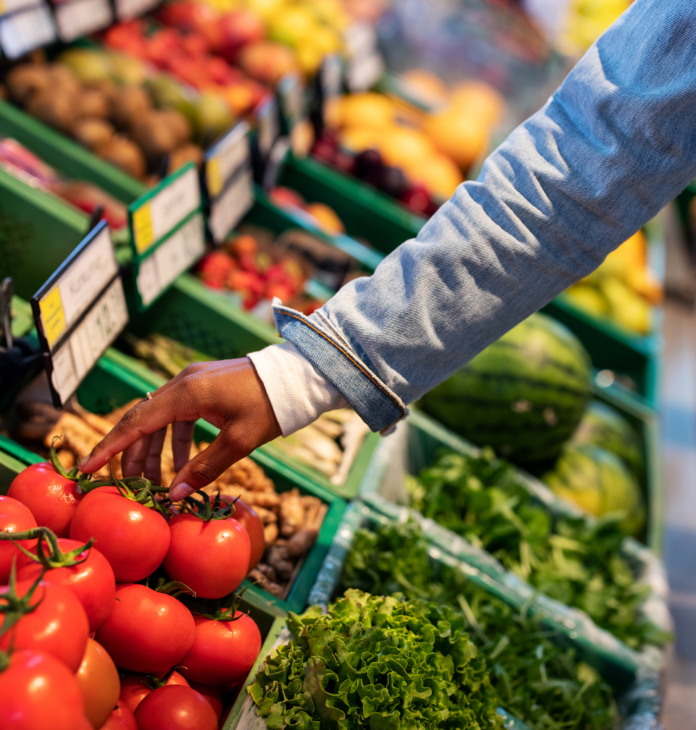
Smart Grocery Recommendation System
An Intelligent Shopping Companion

Slide 2
Overview
Understanding consumer behavior, wants & needs is crucial in the world of retail
Customers may forget to grab an item while shopping, or may not realize they need a product until after they've left with their groceries
The Smart Grocery Recommendation System aims to solve 4 key problems
1. Identify which products are frequently purchased together
2. Recommend items a customer is most likely to buy based on their basket
3. Group customers into meaningful segments based on behavior
4. Predict future demand trends to support stocking decisions

Slide 3
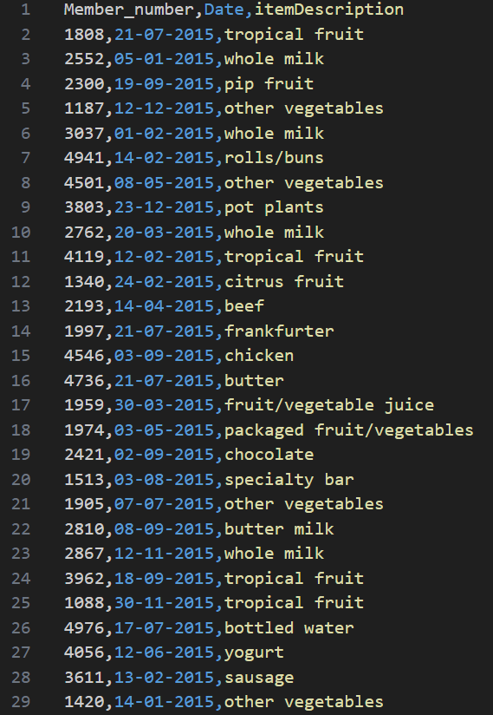
The Dataset
Consists of over 38,000 transactions over the course of 2 years
Over 170 unique grocery items, almost 4,000 customers
Each transaction consists of a unique member number, date of purchase, and product

Slide 4
METHODOLOGY
1. Market Basket Analysis
Utilizes Apriori algorithm to identify frequent itemsets from transactional data
Apply Association Rule Mining to itemsets to develop if-then rules
Example:
{bread, butter} → eggs
All rules found are ranked by the following criteria: • Top frequent items by support
• Top rules by confidence
• Top rules by lift
Recommendation Engine searches for given number of rules matching the current basket, and recommend based on these rules

Slide 5
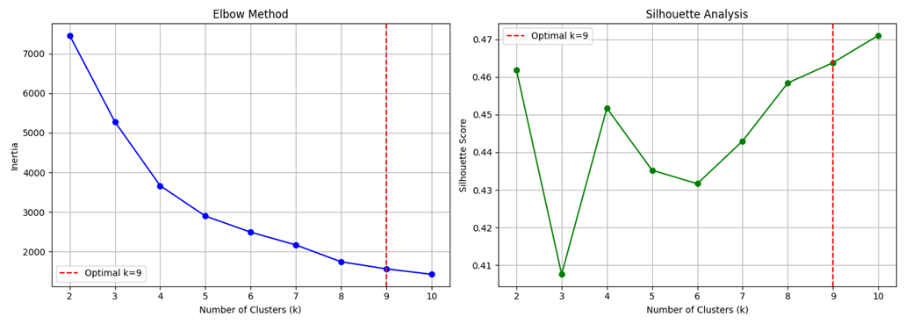
METHODOLOGY
2. Customer Segmentation
Identify features of interest that are unique to customers
• total_items purchased
• unique_items
• avg_basket_size
• diversity_ratio (unique_items / total_items)
Customers classified as light, regular, & premium shoppers
Clustering analysis done primarily with K-Means clustering
Optimal K = 9 clusters, found via Elbow & Silhouette methods

Slide 6
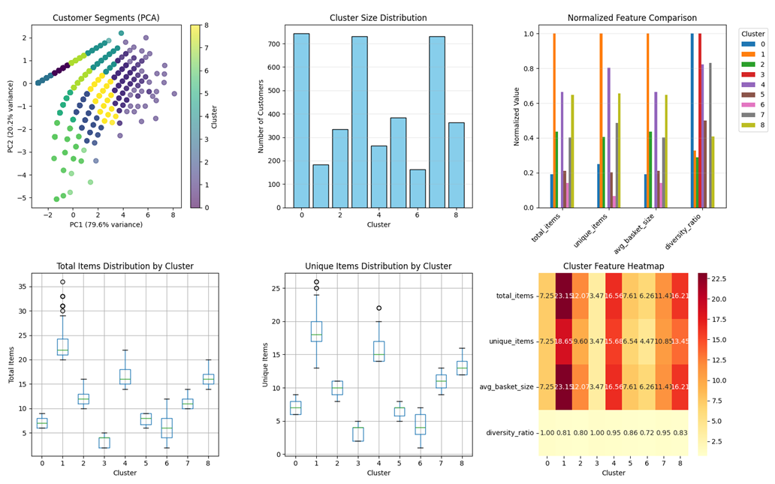
Clustering Results

Slide 7
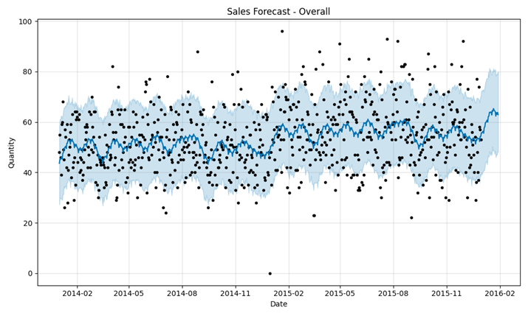
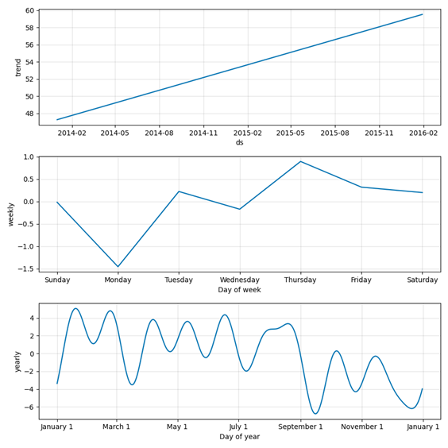
METHODOLOGY
3. Time-Series Forecasting
Forecasting done using Prophet prediction modeling
Model outputs its prediction along with a confidence interval
Provides sales analytics for different timeframes (weekly, yearly, all-time), as well as general trends

Slide 8
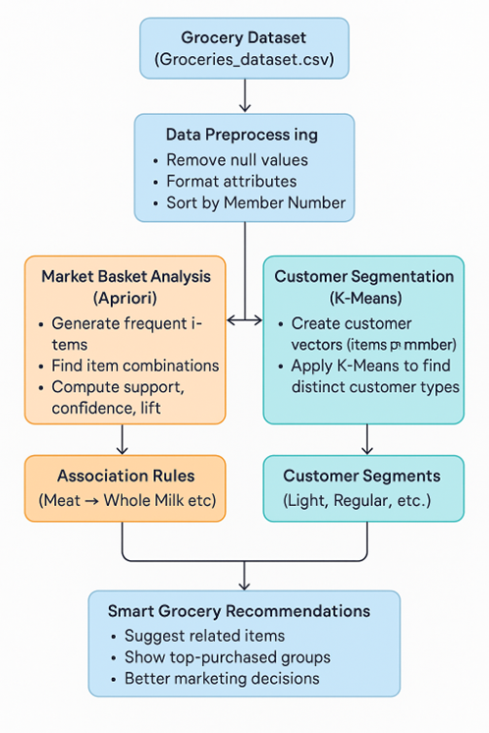
Project Workflow

Slide 9

THANK YOU
Any Questions?

